Slide 1

TYRE AIR PRESSURE MONITOR
BY:
TEAM M2
MOHAMED AKHEEL. M
MOHAMED IBRAHIM

Slide 2
NEED ANALYSIS
We have all faced a problem of flat tire at least once in our life time.
There may be some situations when we are on a highway and our type is flat and there are no shops nearby.
In this worst-case scenario, we have to call for help from a mechanic who would reach our location after a long time.
When this happens, there is no other go but to wait.
This is where our idea comes into play.

Slide 3
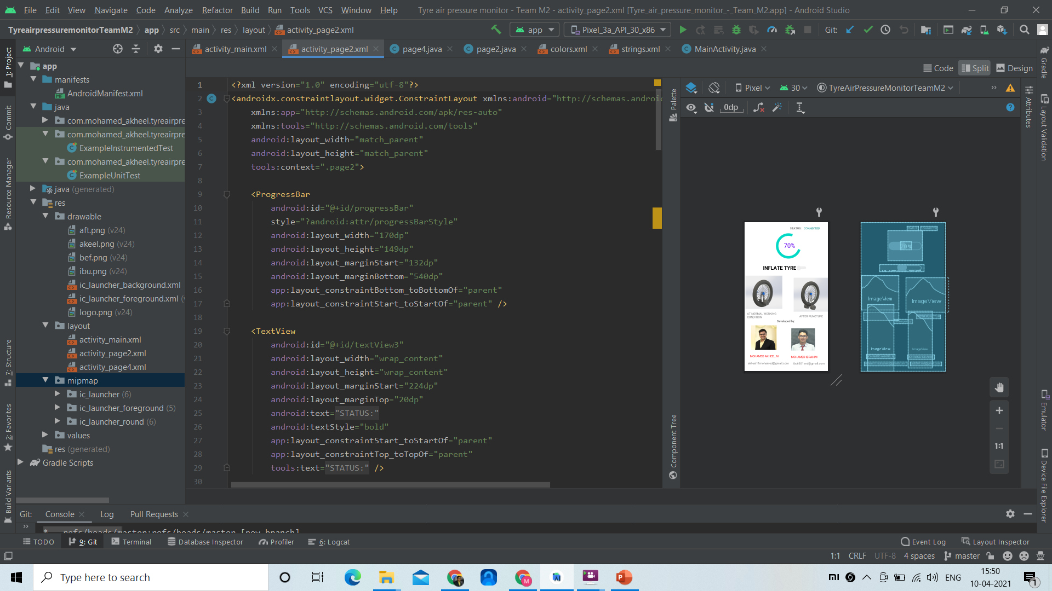
SOFTWARE USED
ANDROID STUDIO

Slide 4
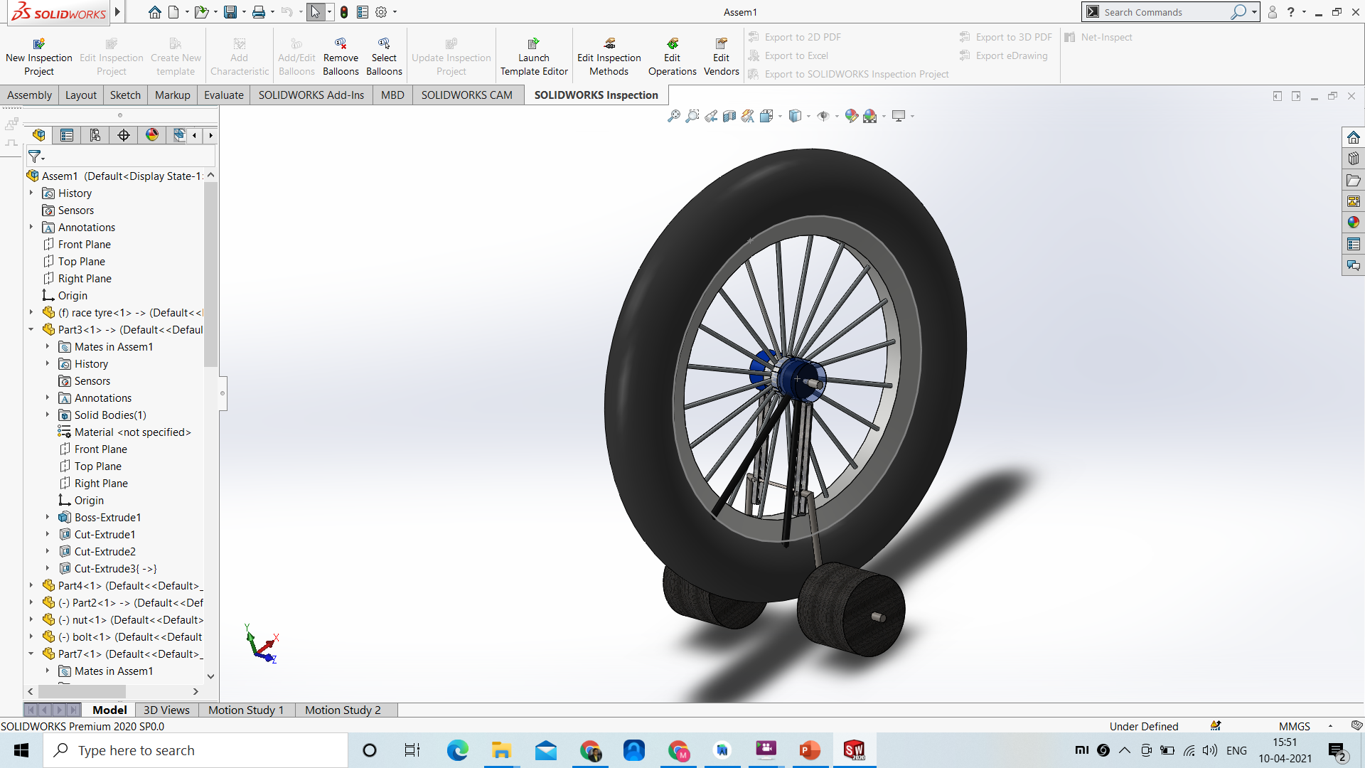
SOFTWARE USED
SOLIDWORKS

Slide 5
WORKING MECHANISM
To check the air pressure in tyre, constant volume of water is present a cylinder connected to the tyre.
With decrease in the air pressure the water pressure also varies, as the water moves down due to low pressure created.
This level of water is indicated using sensor and monitored by application.
The stepney tyres are placed with the help of sliding rod that slides down during puncture.
During puncture the tyre is inflated immediately with the help of a plunger operated through an application.

Slide 6
advantages
User could be mentally free about air pressure in tyres.
Proper maintenance of tyres could be achieved.
Less effort needed to operate the two-wheeler in case if the two-wheeler is punctured

